Slide 1
Thrift-Store
Presented by: Rakesh Chhetri
Presented by: Anish Thapa

Slide 2
Introduction
Thrifting is simply buying from stores that sell pre-loved, second-hand clothes, accessories, and lifestyle products.
Thrift stores are not only popular for their budget-friendly shopping options but also for the treasure-hunting experience they offer.
thrift stores are run by charitable organizations or non-profits, with proceeds often going towards supporting various social causes or community programs.

Slide 3
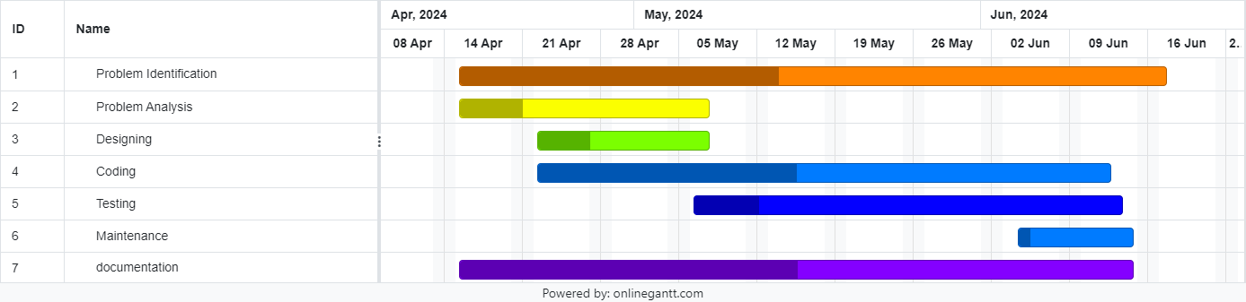
Gannt Chart

Slide 4
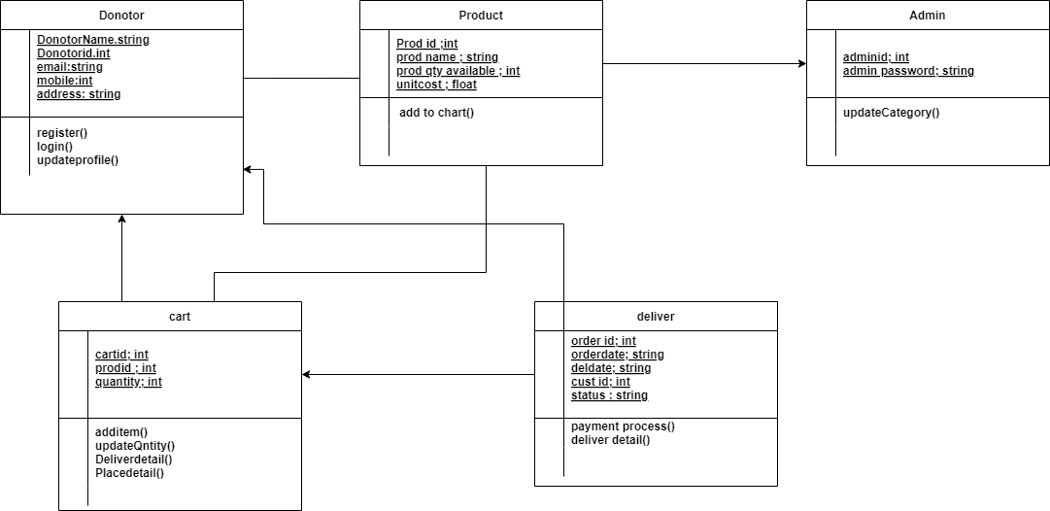
Er-Diagram

Slide 5
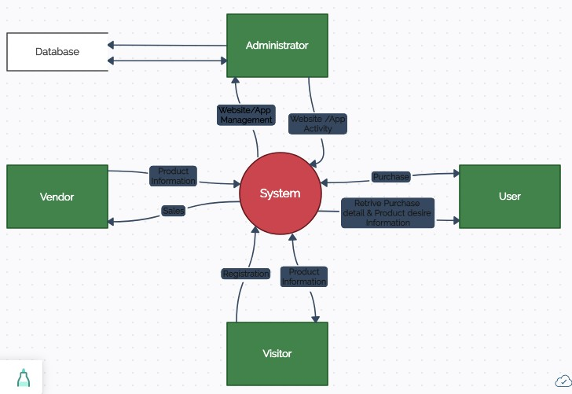
DFD 0

Slide 6
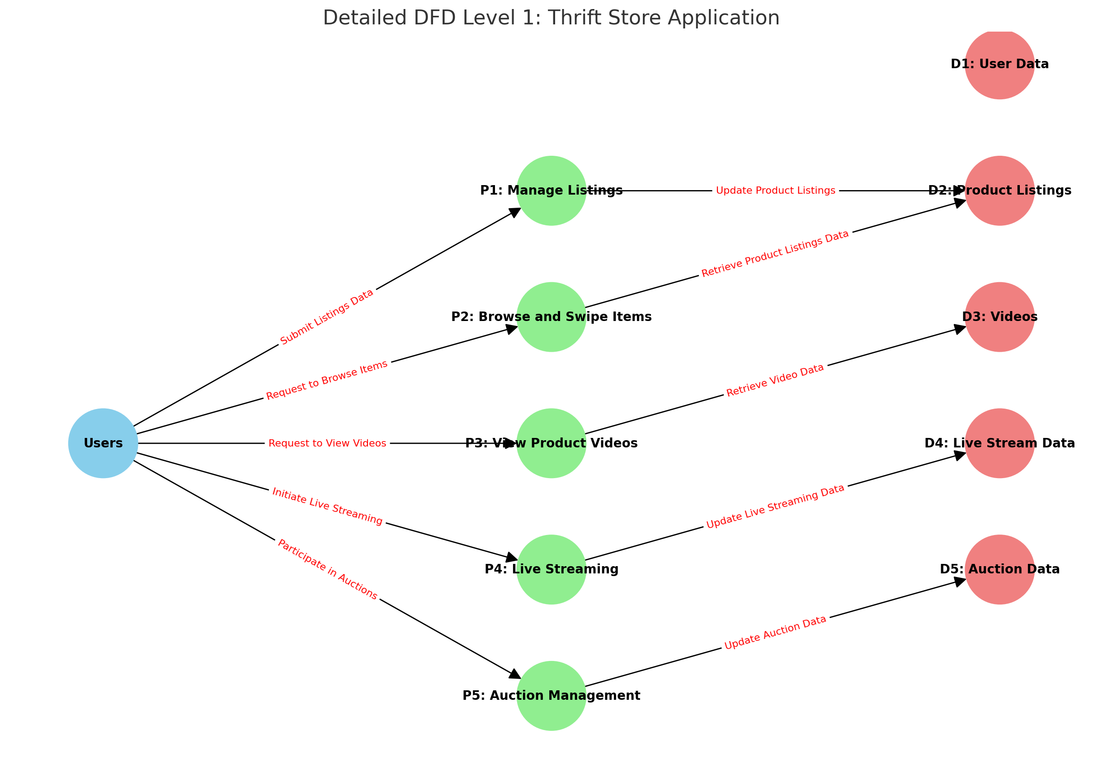
DFD 1

Slide 7
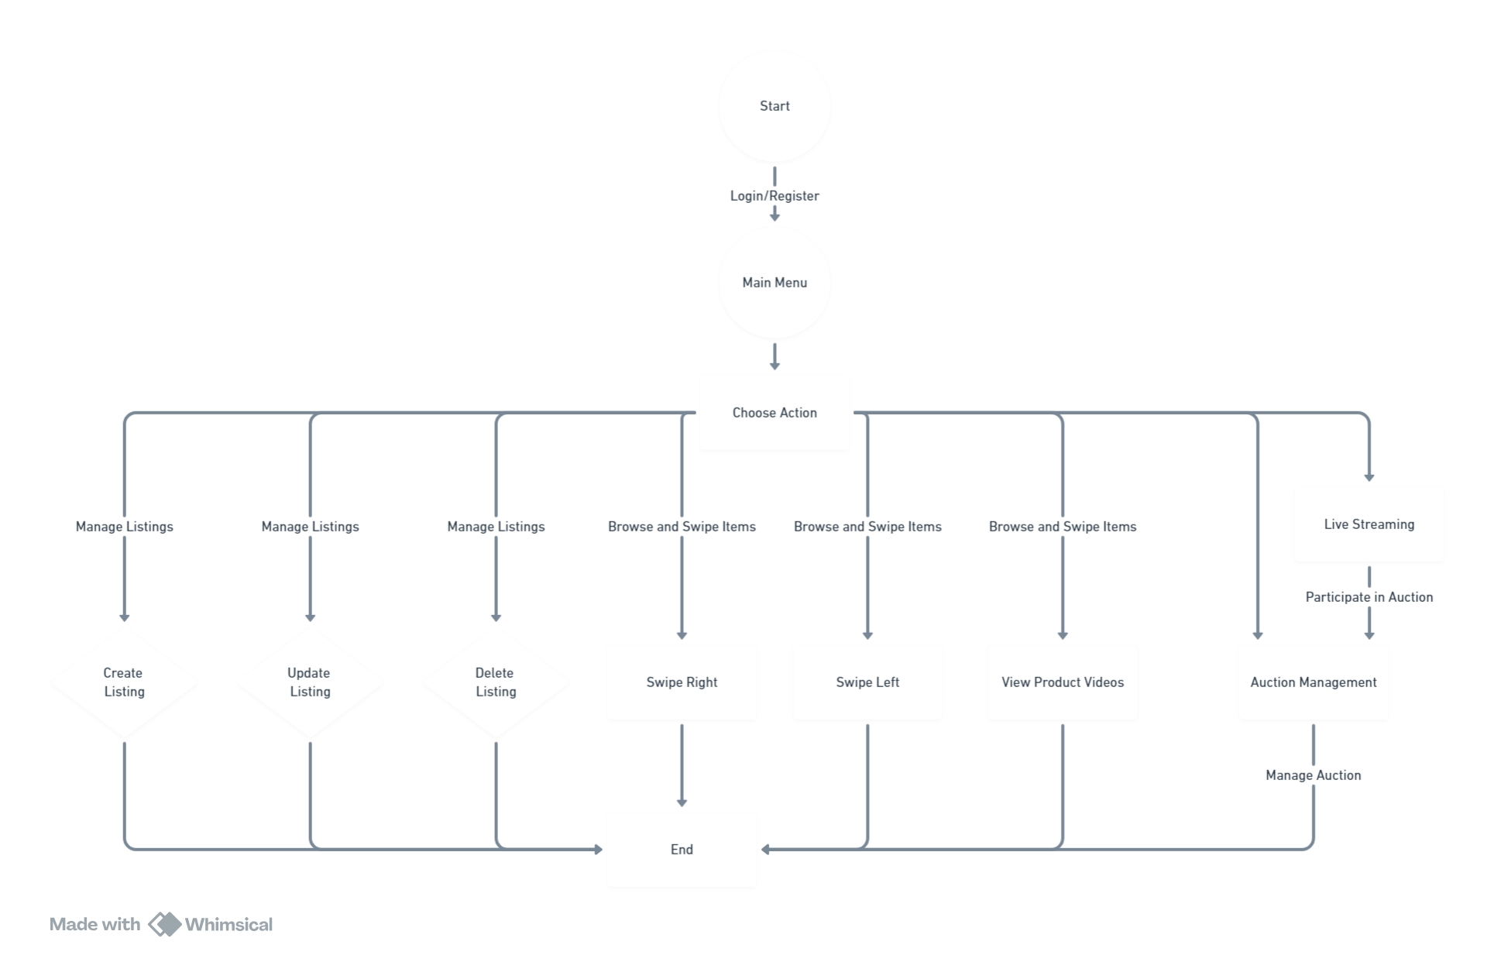
Flowchart

Slide 8
Demo

Slide 9
THANK YOU!!!

